Slide 1
Boating Collision Warning and Identification
4th Year Project 2020
Daniel Ellingwood, Jonathan Lunn, Sean Sullivan, Joseph Amiah, Jennifer Tryon, Farhan Chowdhury

Slide 2
Project Summary
The Boating Collision Warning and Identification System will be capable of detecting and identifying a range of different objects underwater that could pose danger while boating. Such objects include rocks, logs, and weeds. The system would be able to distinguish between these objects and give warning to the boater before the collision occurs. A combination of hardware, software and AI would be needed to create these results. Bathymetric LIDAR technology would be used to give improved imagining results underwater.

Slide 3
General System Diagram
Jennifer, Farhan, Sean
Daniel, Jonathan, Kingsley

Slide 4
Work Breakdown
Hardware | Software
Lidar system Bluetooth communication system Power system Remotely adjustable attachment arm 3D printed packaging | General Android application design Communication via Bluetooth Attachment arm controls Machine Learning model training and production deployment

Slide 5
Primary Group Role Assignments
Role | Group Member
LiDAR Hardware Designer | Daniel
LiDAR System & Power Designer | Jonathan
General Application Developer | Jennifer
AI Developer | Sean
Communications Designer | Kingsley
LiDAR Software Designer | Farhan

Slide 6
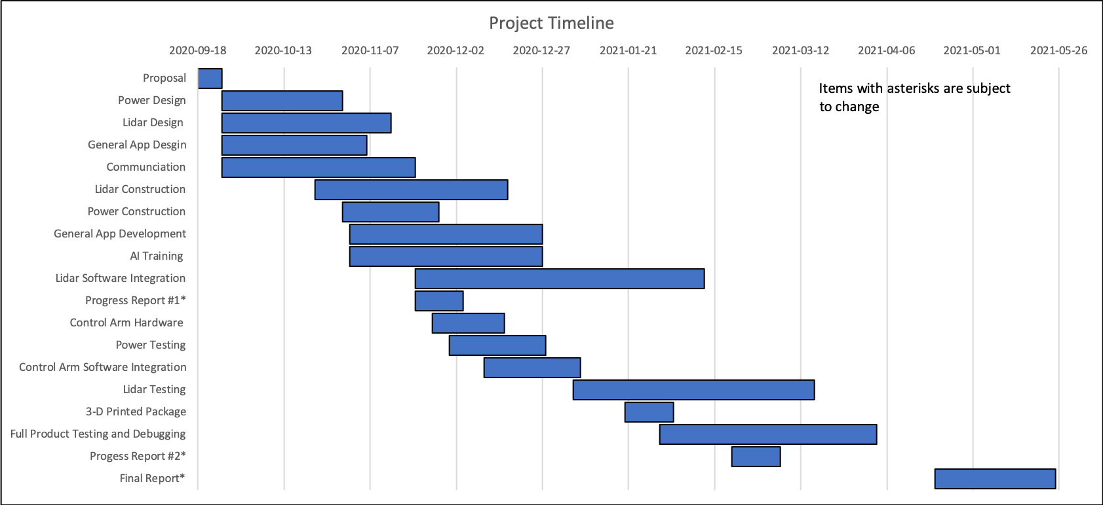
Initial Project Timeline

Slide 7
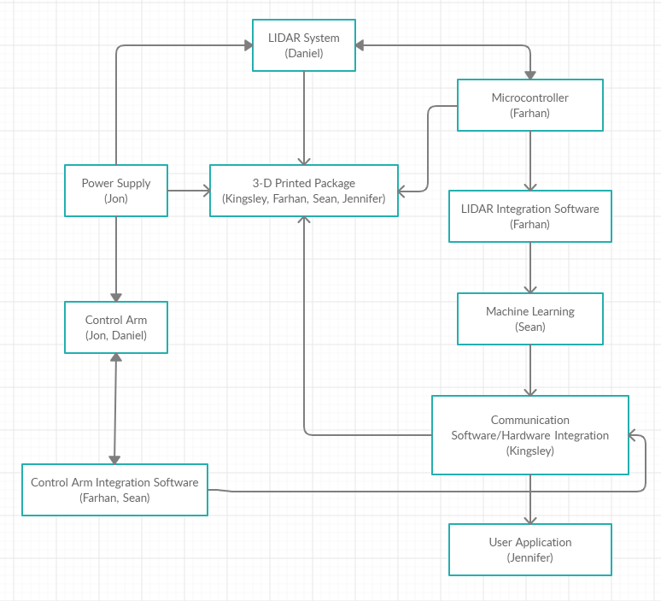
General Project Schematic

